Slide 1
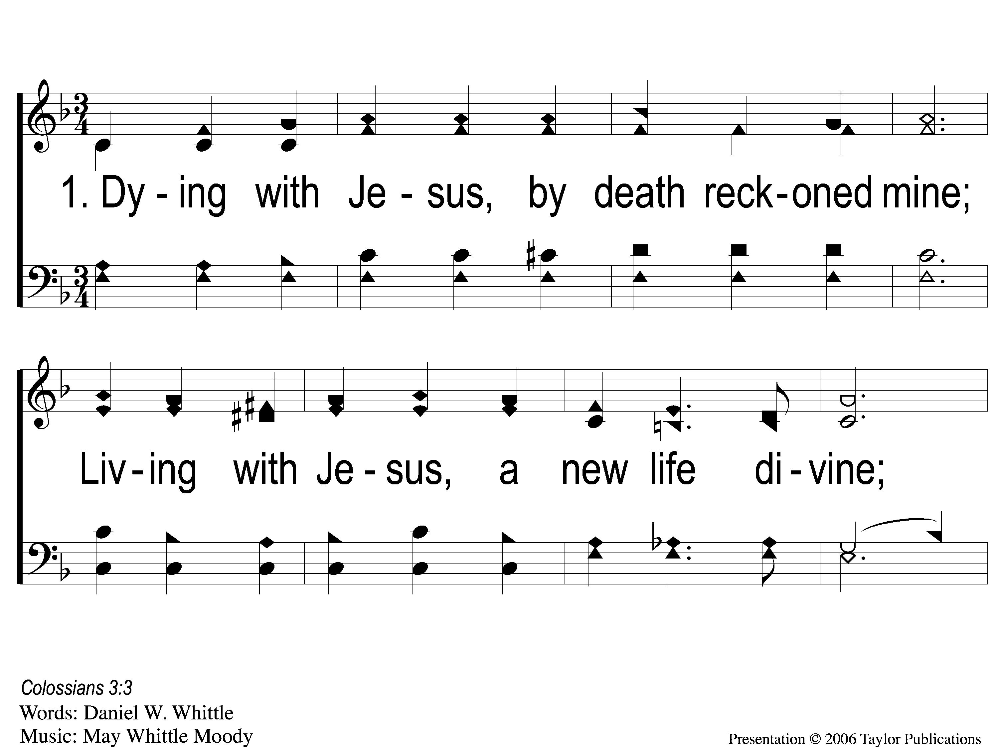
1-1 Dying With Jesus
Dying With Jesus
55

Slide 2
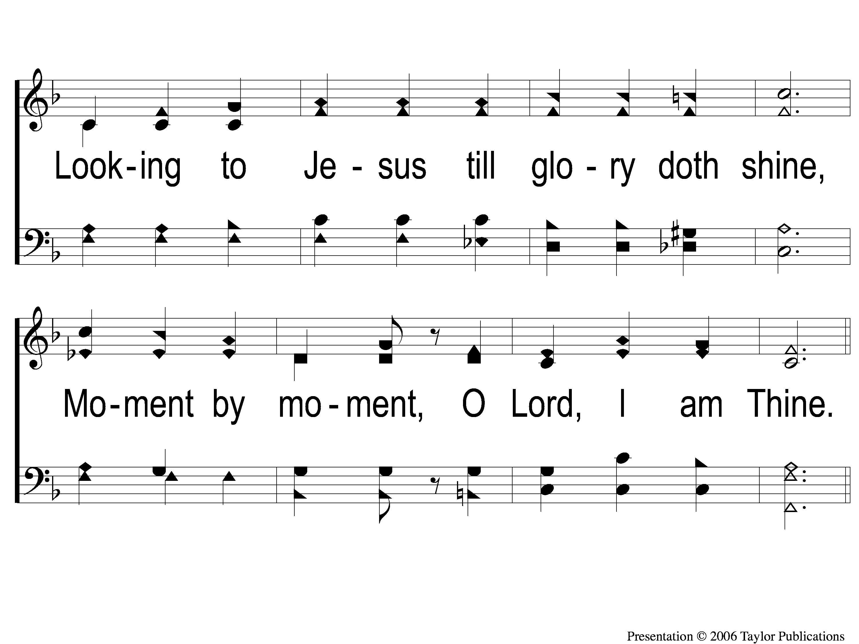
1-2 Dying With Jesus
Dying With Jesus
55

Slide 3
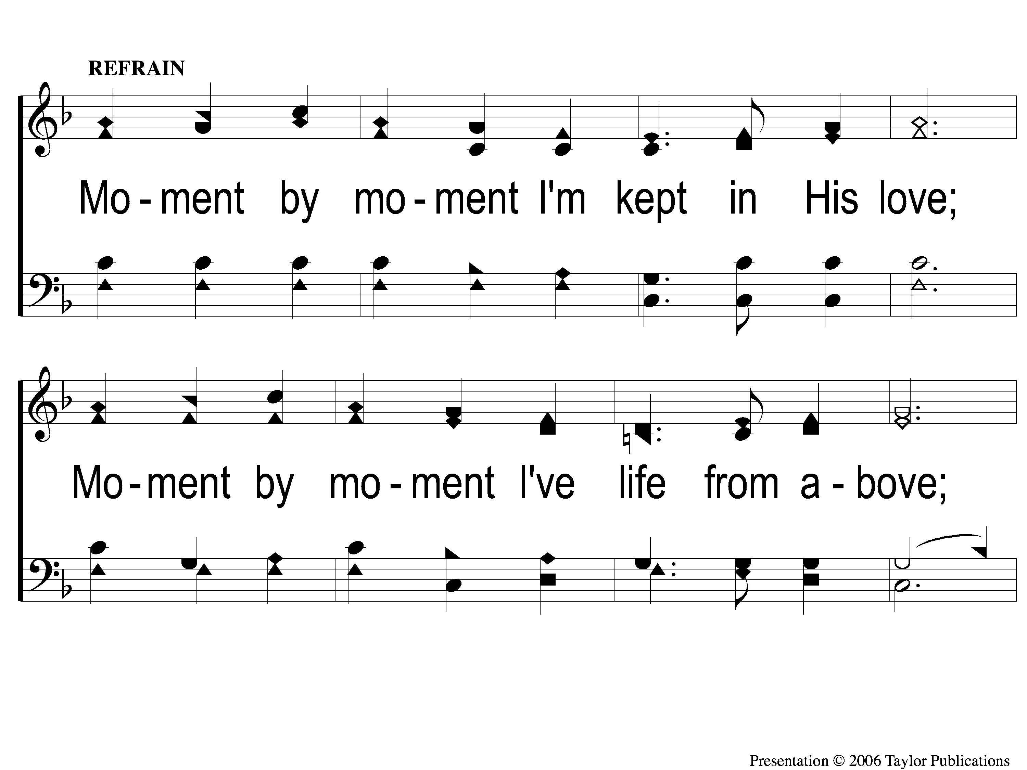
C-1 Dying With Jesus
Dying With Jesus
55

Slide 4
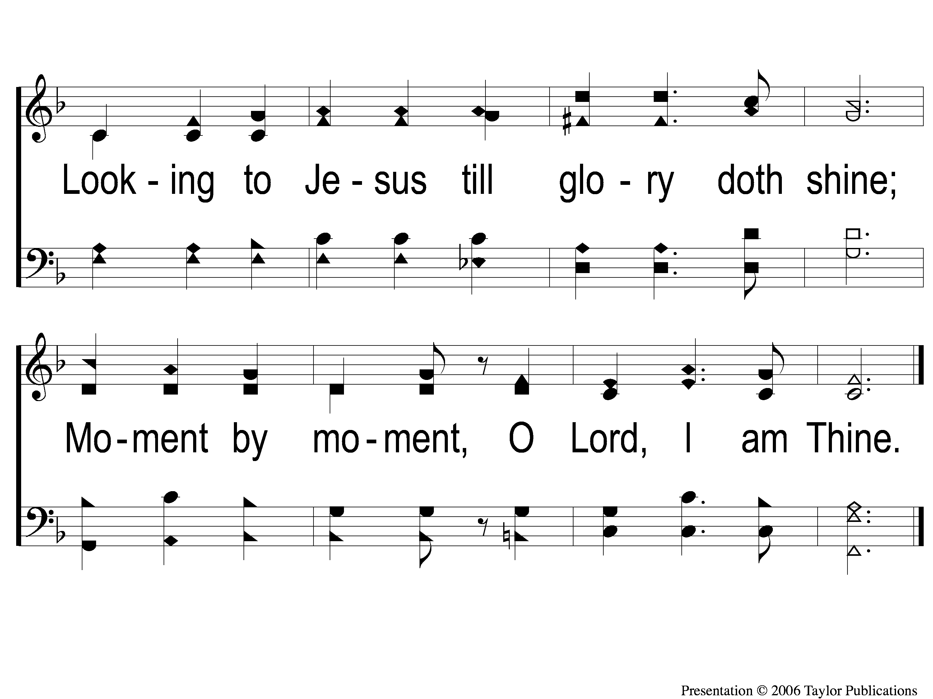
C-2 Dying With Jesus
Dying With Jesus
55

Slide 5
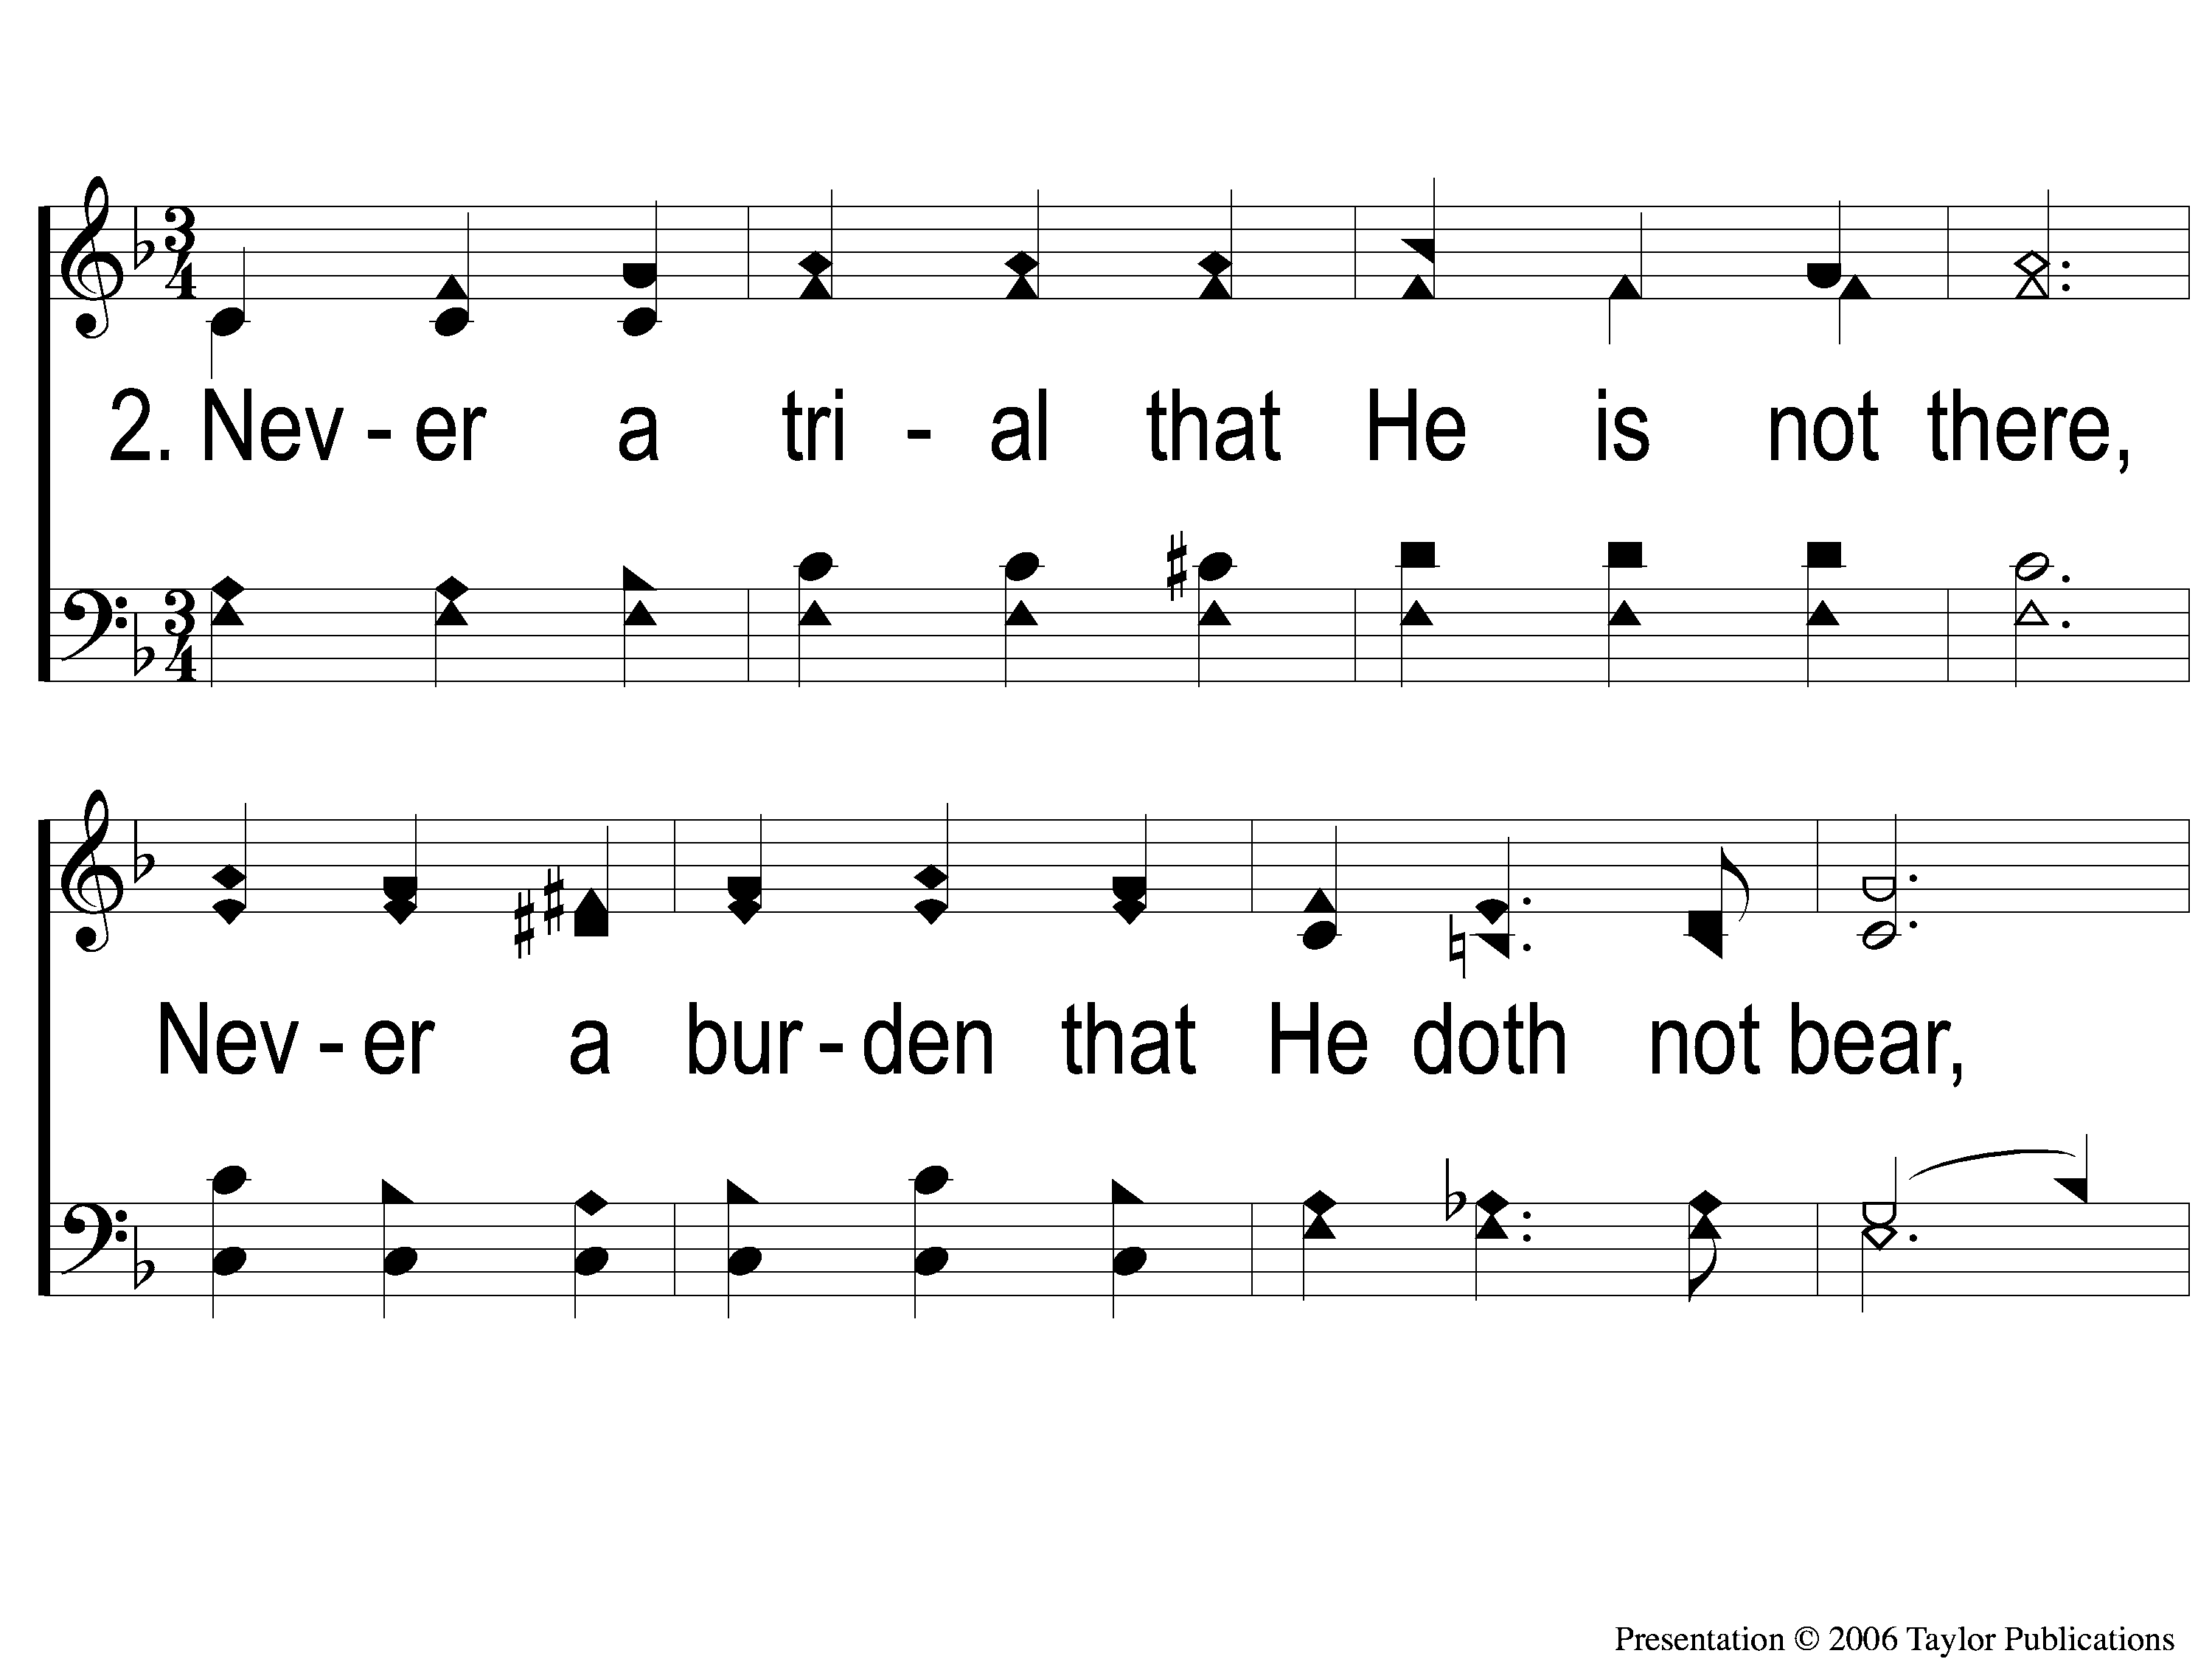
2-1 Dying With Jesus
Dying With Jesus
55

Slide 6
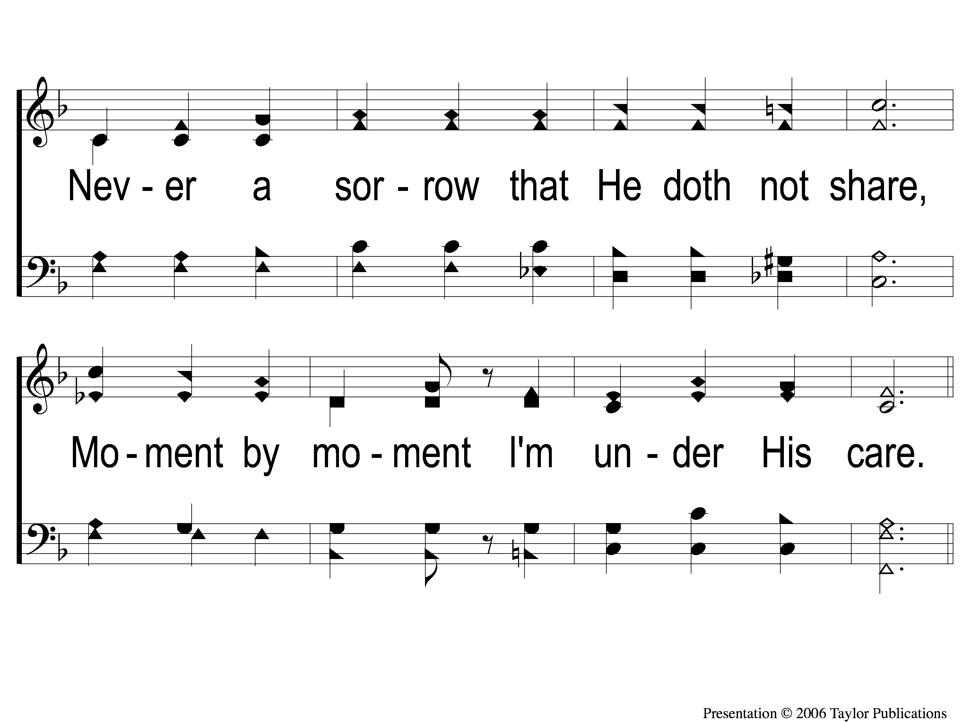
2-2 Dying With Jesus
Dying With Jesus
55

Slide 7
C-1 Dying With Jesus
Dying With Jesus
55

Slide 8
C-2 Dying With Jesus
Dying With Jesus
55

Slide 9
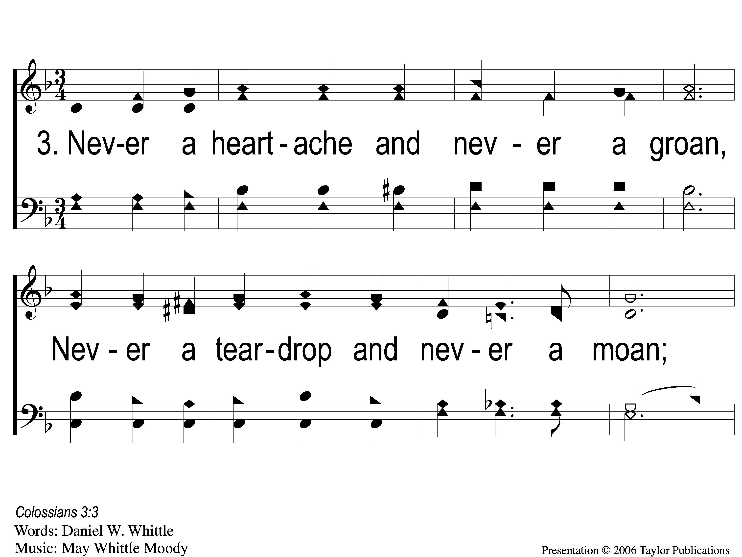
3-1 Dying With Jesus
Dying With Jesus
55

Slide 10
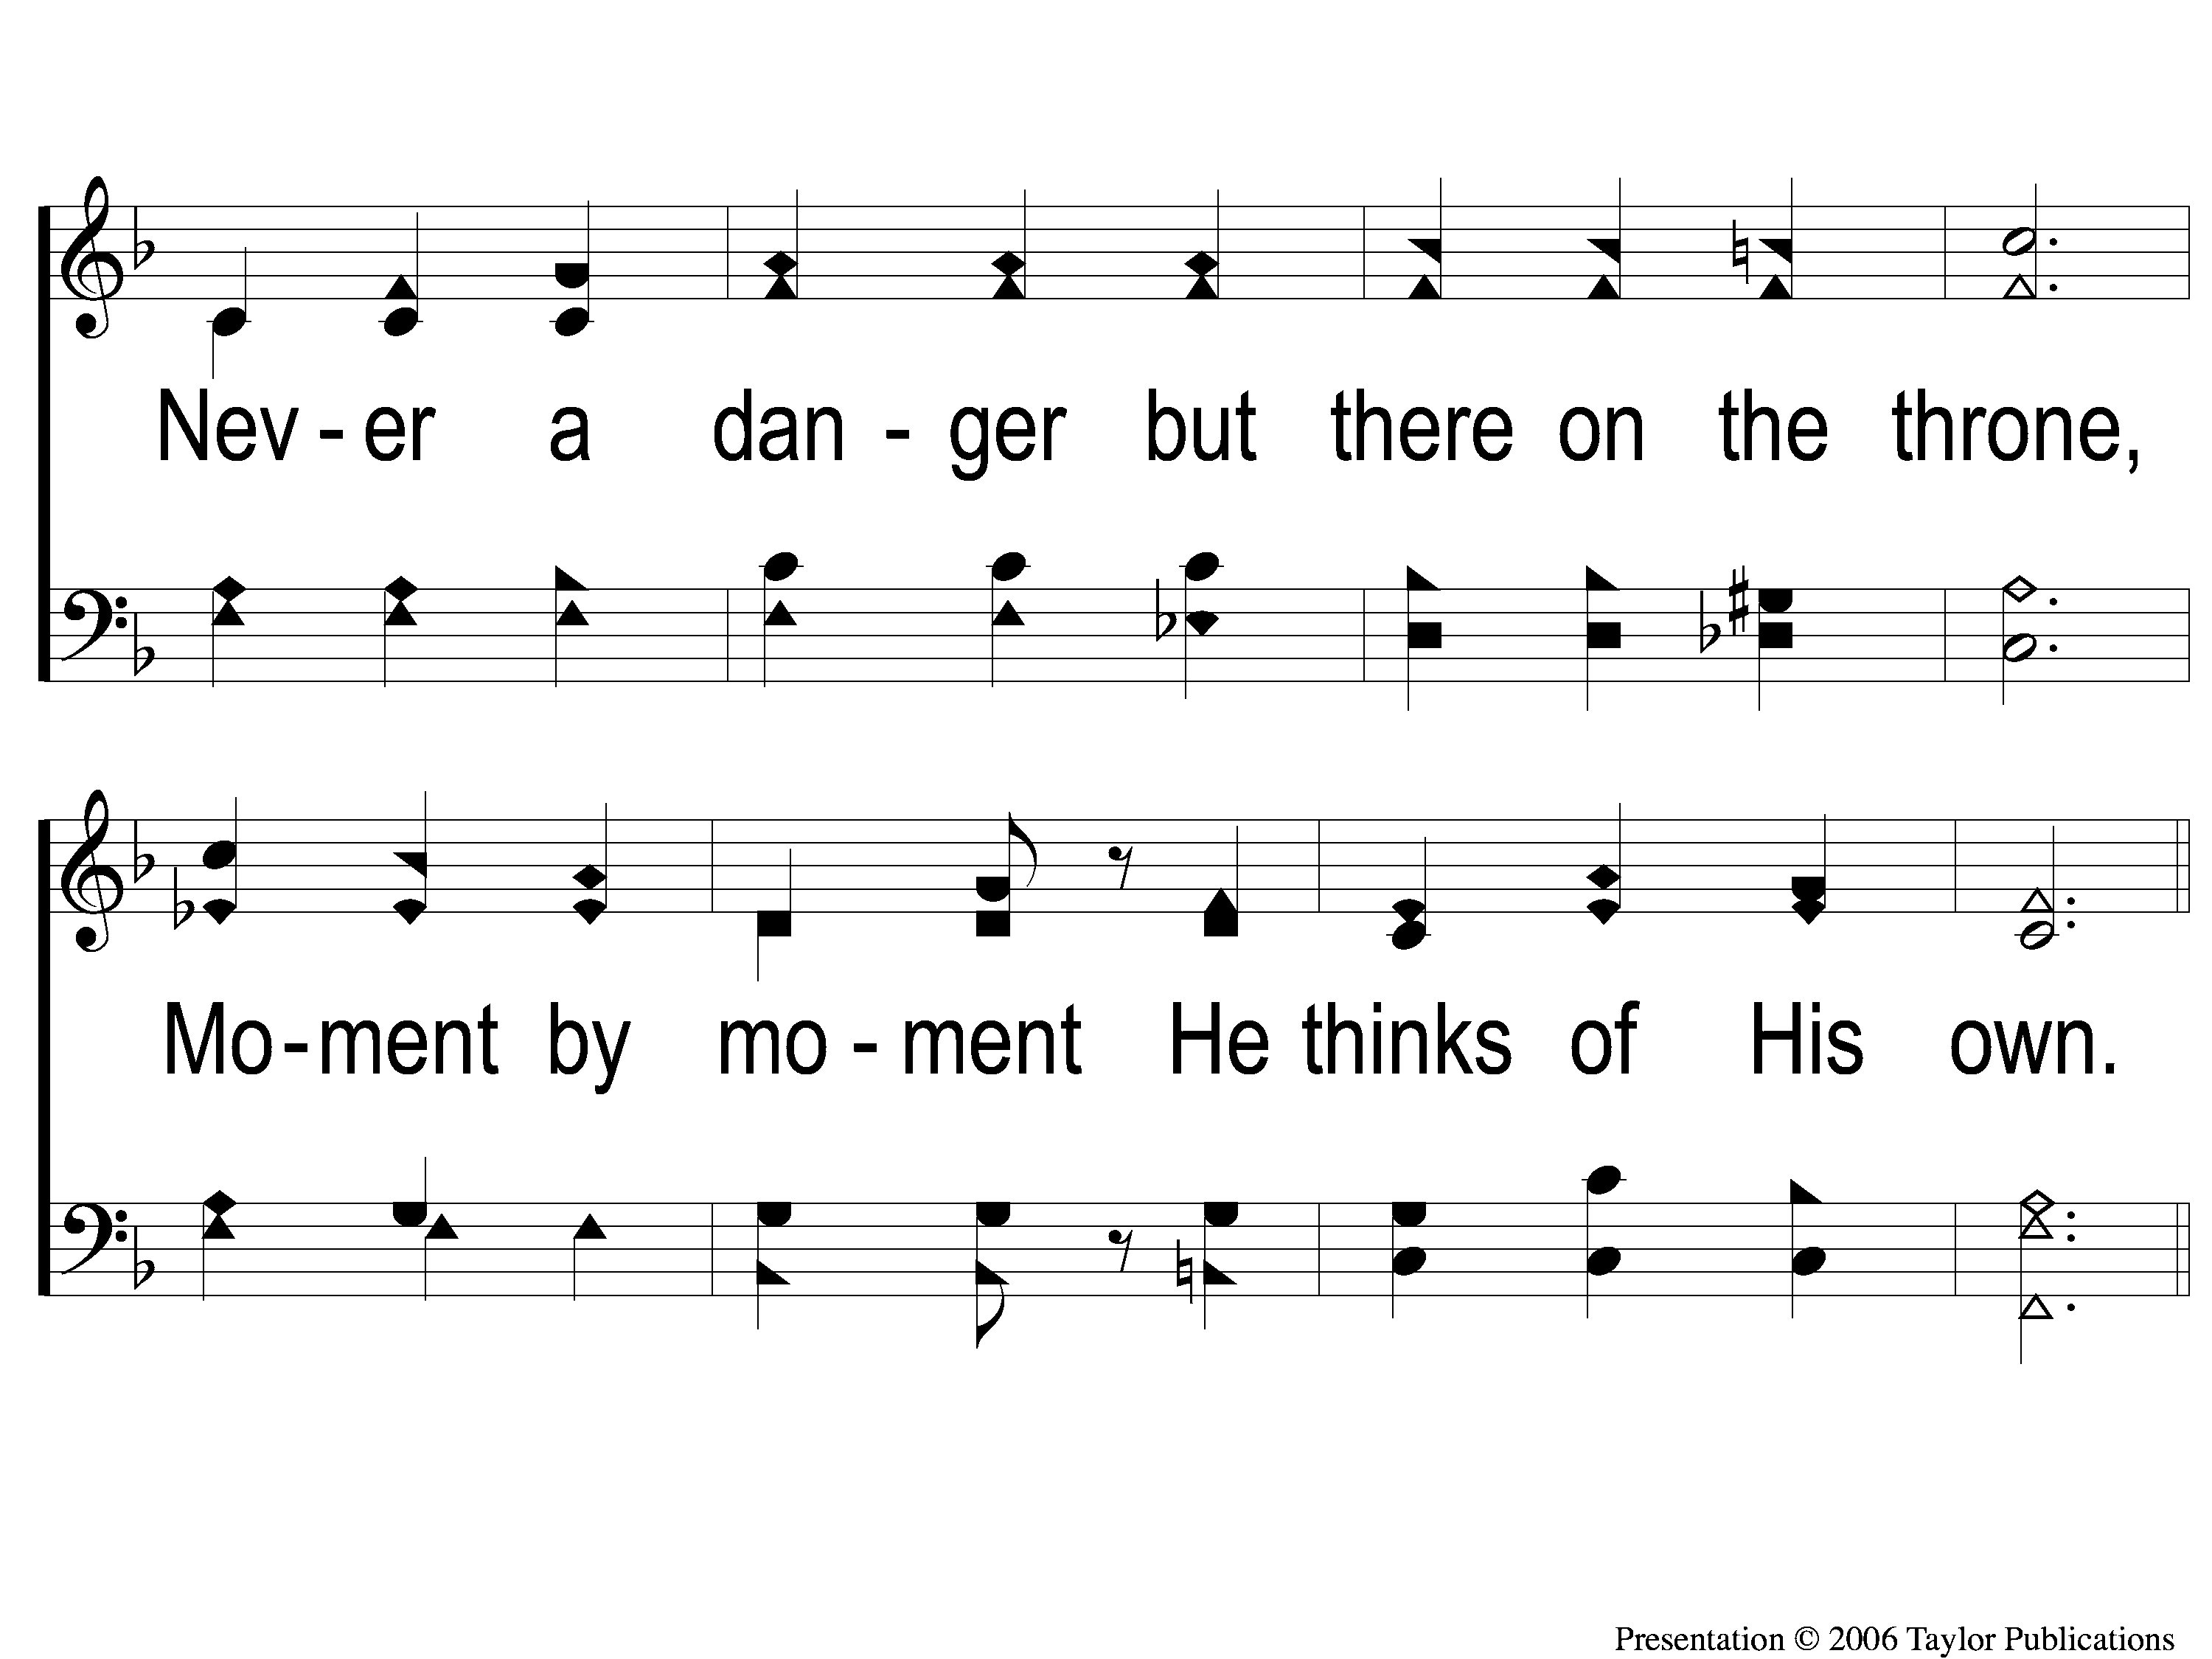
3-2 Dying With Jesus
Dying With Jesus
55

Slide 11
C-1 Dying With Jesus
Dying With Jesus
55

Slide 12
C-2 Dying With Jesus
Dying With Jesus
55

Slide 13
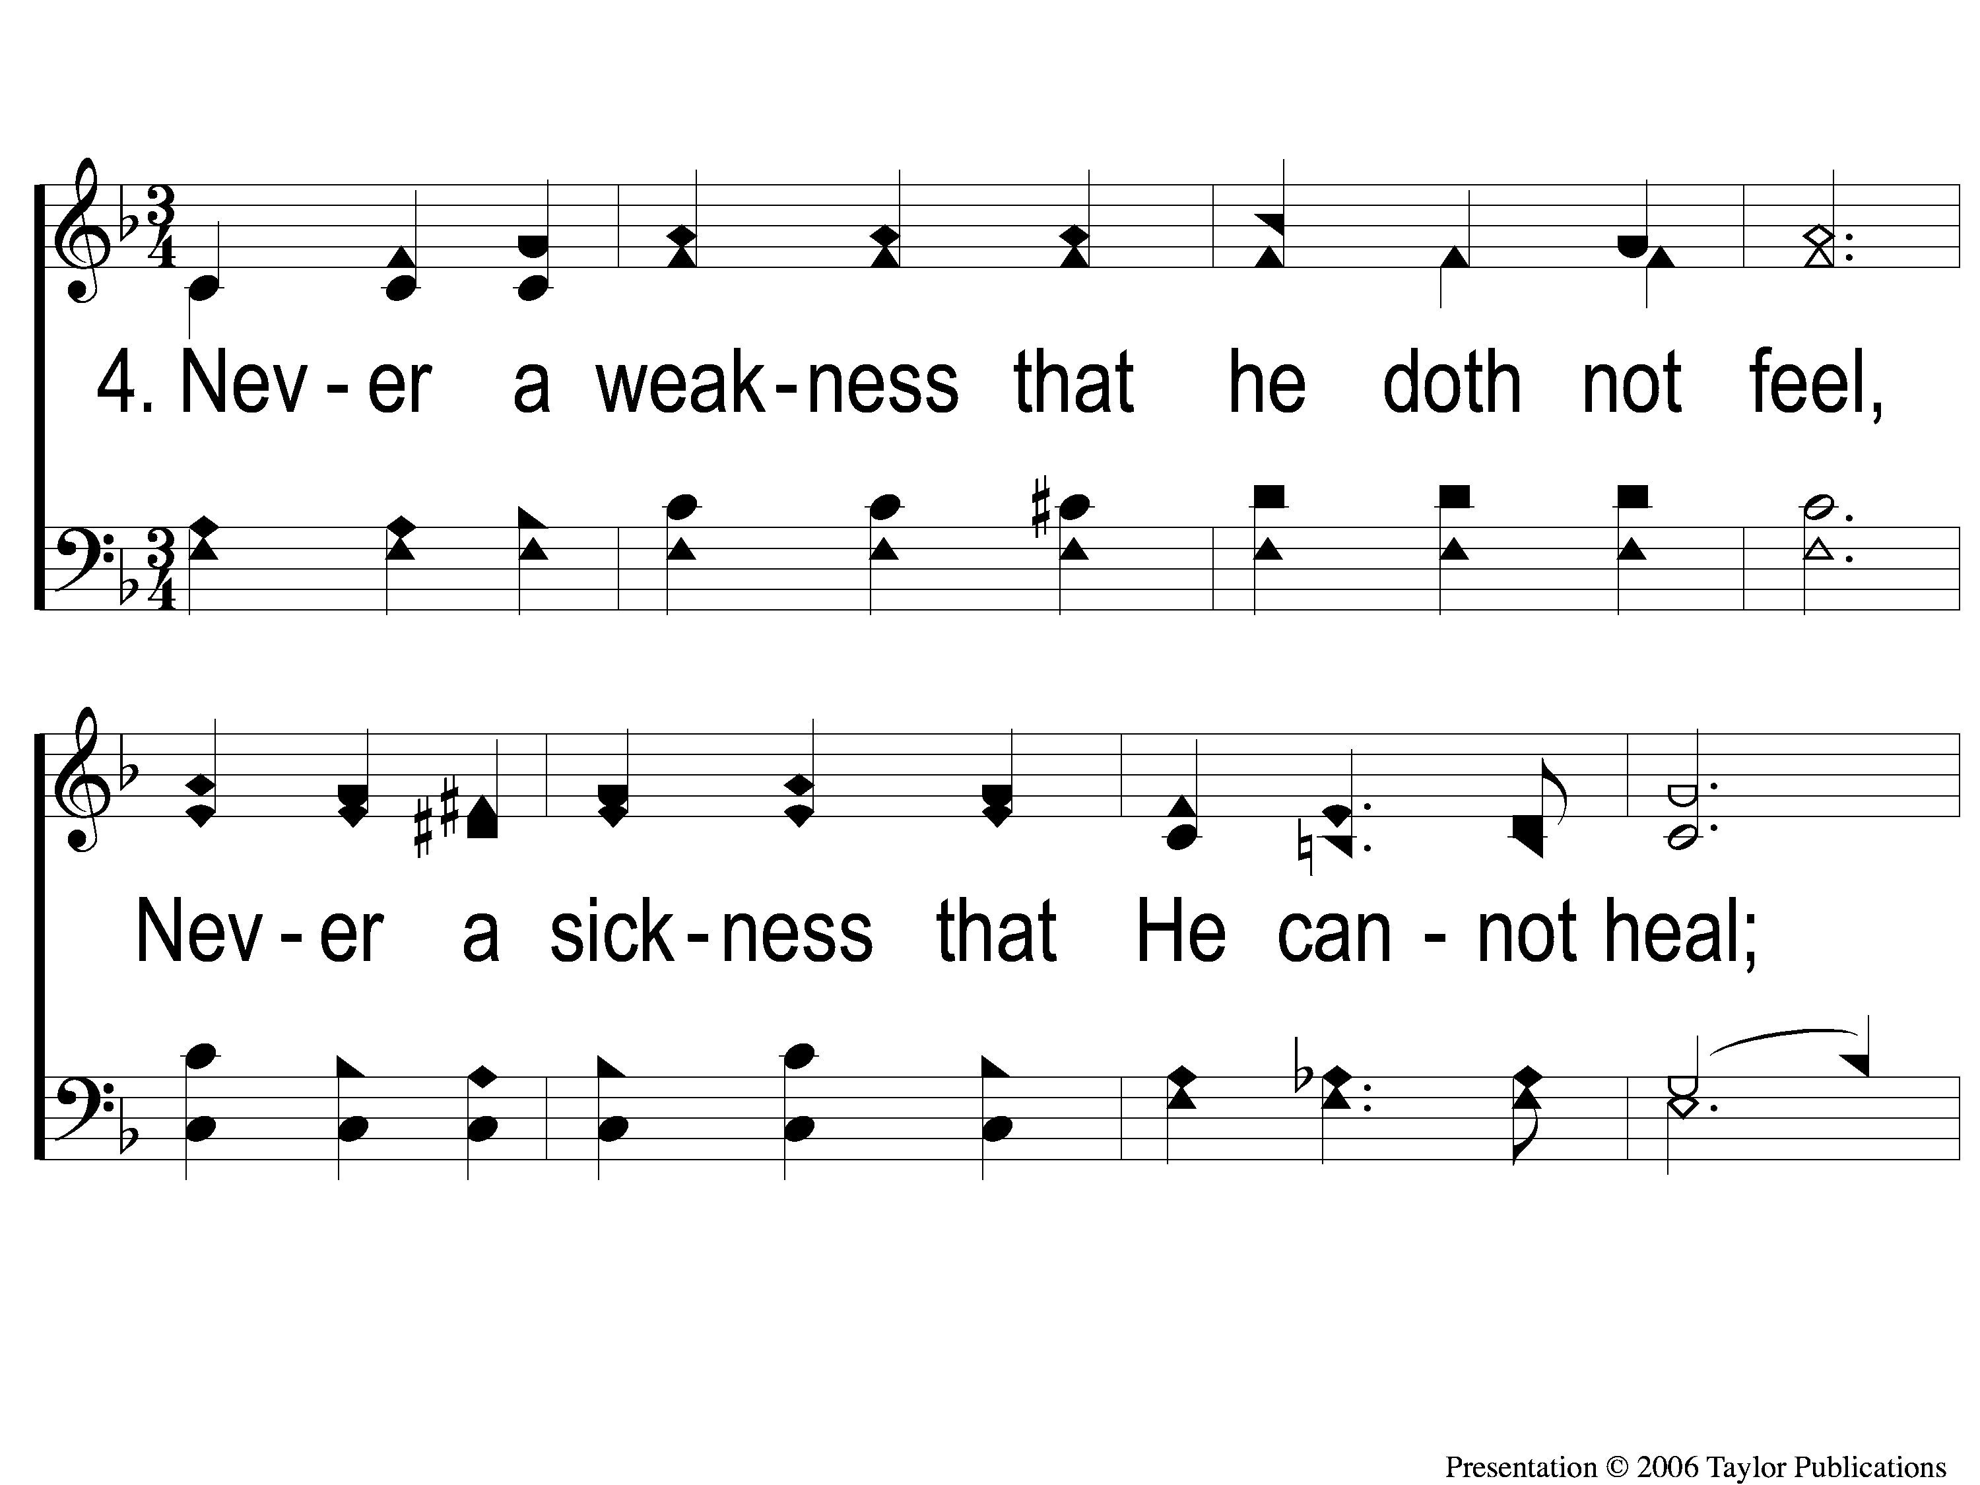
4-1 Dying With Jesus
Dying With Jesus
55

Slide 14
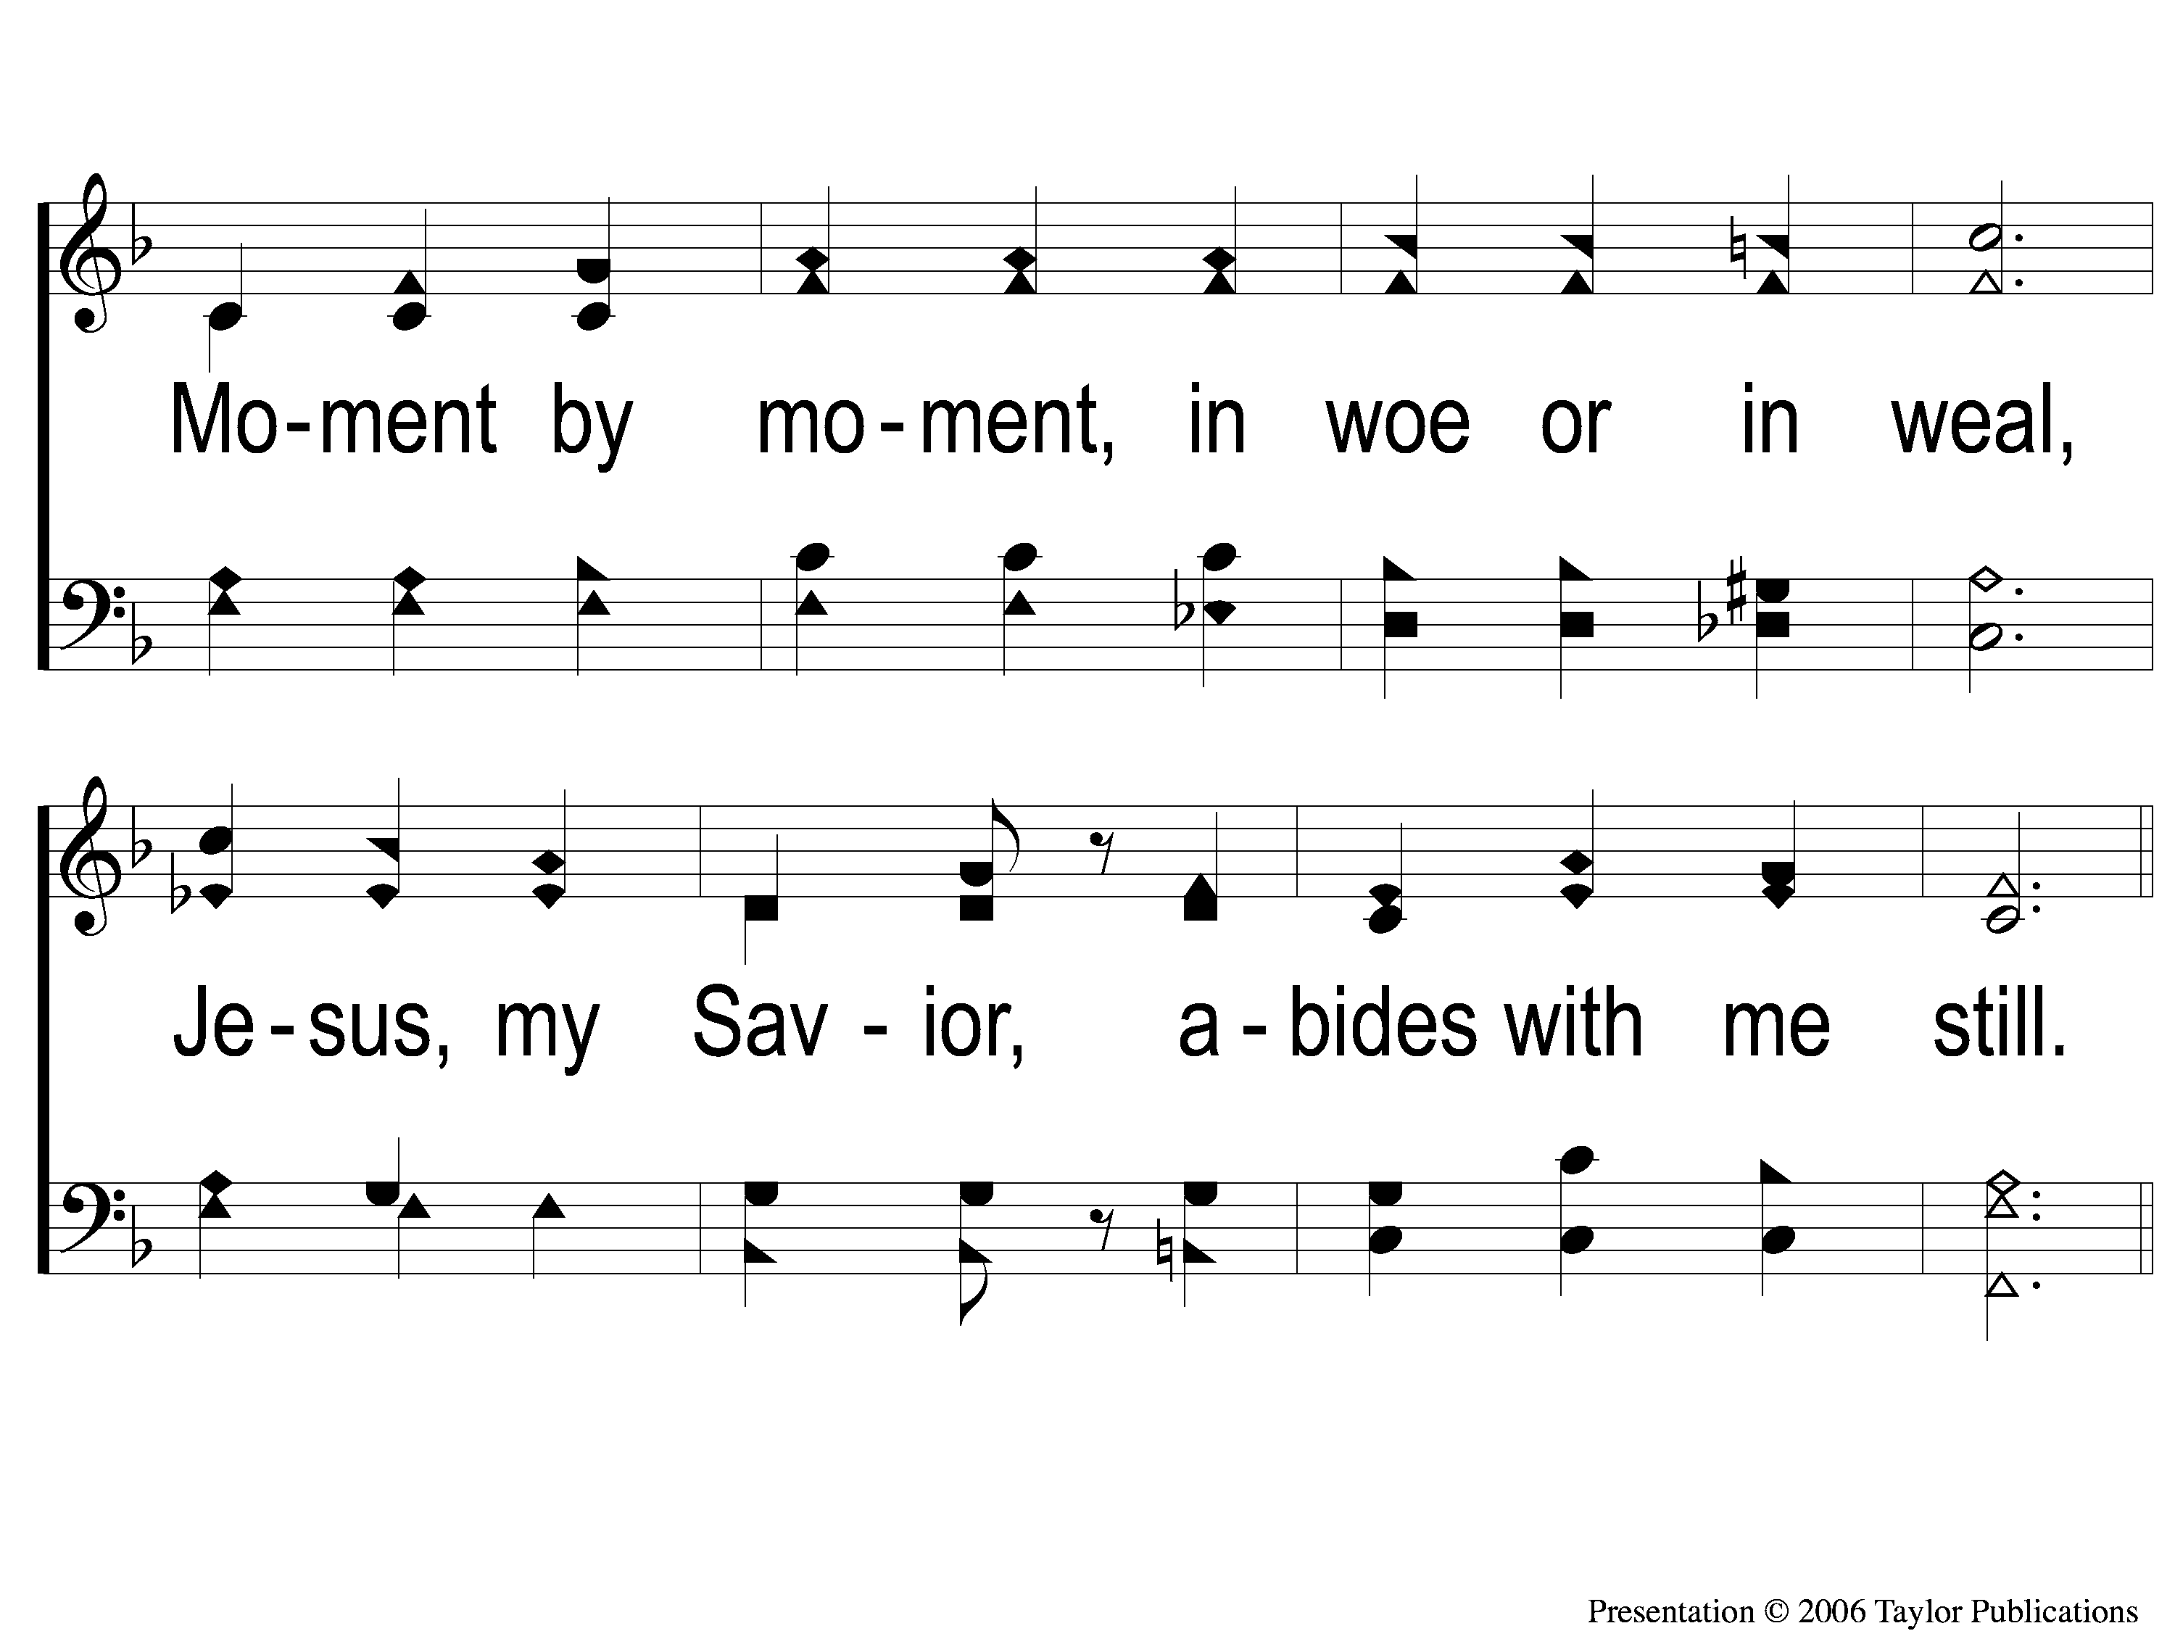
4-2 Dying With Jesus
Dying With Jesus
55

Slide 15
C-1 Dying With Jesus
Dying With Jesus
55

Slide 16
C-2 Dying With Jesus
Dying With Jesus
55

